Slide 1
Activity Recognition with Motion History Images and Deep Learning
By: Aral Sarrafi
Instructor: Prof. Yu Cao

Slide 2
Motivation
2D image classification is well studied problem in the context of computer vision.
Action Recognition is a more complicated task because of having the additional temporal dimension in the analysis.
Action recognition can have different applications such as: interactive environments, security , and public crowd control.
It also has potential applications in structural health monitoring.

Slide 3
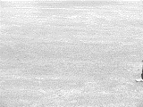
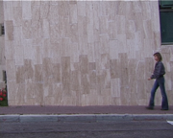
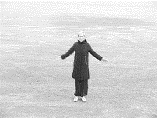
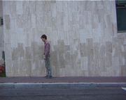
The annotated data set
Kth data set: 600 videos, 6 classes
WEIZMANN data set: 90 videos, 10 classes
…
…
Walking
Walking
…
…
Clapping
Bending
…
…

Slide 4





Implementation Libraries and Programming Languages
OpenCv as the computer vision library
Python as the base programming language
Tensor Flow (TF) for deep learning
Jupyter Notebook
Structural Health Monitoring from Video Stream

Slide 5
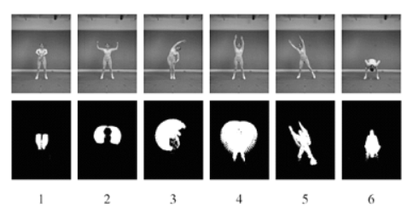
Methodologies
[1] A.F. Bobick, J.W. Davis, The recognition of human movement using temporal templates, IEEE Transactions on pattern analysis and machine intelligence, 23 (2001) 257-267.
Binary image sequence indicating regions of motion
Motion Energy images

Slide 6
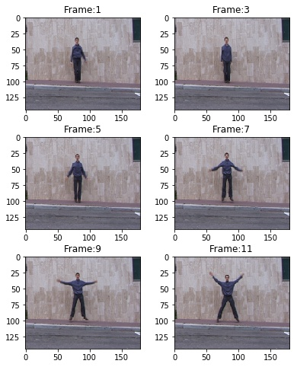
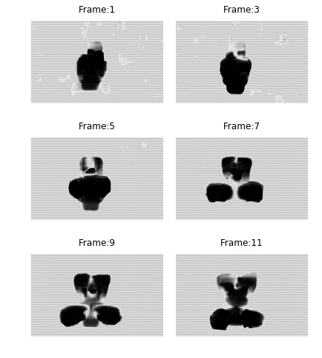
Dense optical flow estimation- Lucas Kanade
Dense Optical Flow
Lucas kanade method (OpenCV)
Frames of Video
Dense Optical Flow

Slide 7
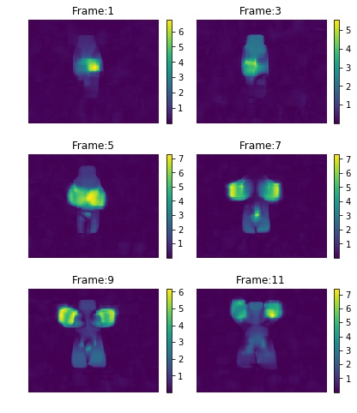
Motion Field Amplitude
Compute the amplitude of the motion field at each frame.
Dense Optical Flow
Amplitude of the motion field

Slide 8
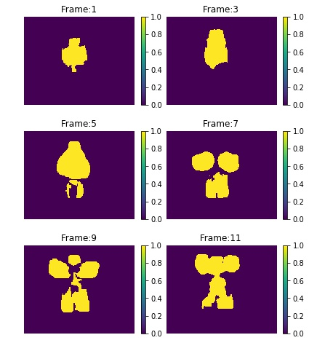
Threshold
Apply a threshold to the amplitude of the motion field to characterize the pixels that have moved.
Amplitude of the motion field
Pixels that have moved

Slide 9
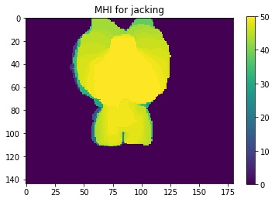
Motion History Images
Motion History Images (MHI)

Slide 10
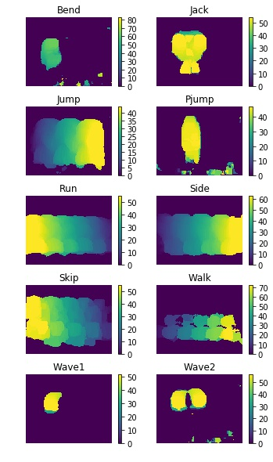
Motion History Images for different actions
The first section of the activity recognition has been conducted in python and OpenCV.

Slide 11

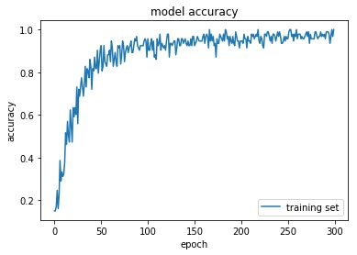
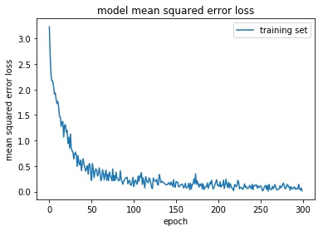
LeNet-5 for classification
LeNet-5
Lenet-5 deep neural network
Convolutional Layer: 6 filters, filter size: (5, 5) , stride : 1
Max Pooling Layer: pooling size: (2, 2), stride, (2, 2)
Convolutional Layer: 16 filters. filter size: (5, 5), stride: 1
Max Pooling Layer: pooling size: (2, 2), stride, (2, 2)
Fully connected Layer with 120 neurons
Fully connected Layer with 84 neurons
Output layer with 10 classes (number of activities in the data set).
Because of having small amount of data the network is very likely to over fit the training data.
The deep Learning section was implemented in Tensorflow with Keras interface.

Slide 12
LeNet-5 for classification
Motion estimation plays a major role in activity recognition.
Each activity will be having its unique Motion history image that can be used for activity recognition.
LeNet-5 deep neural network was used to classify the motion history images.
Having a data set with more data points is going to improve the performance of the pipeline.

Slide 13
Thanks for your time.
Questions

